Slide 1

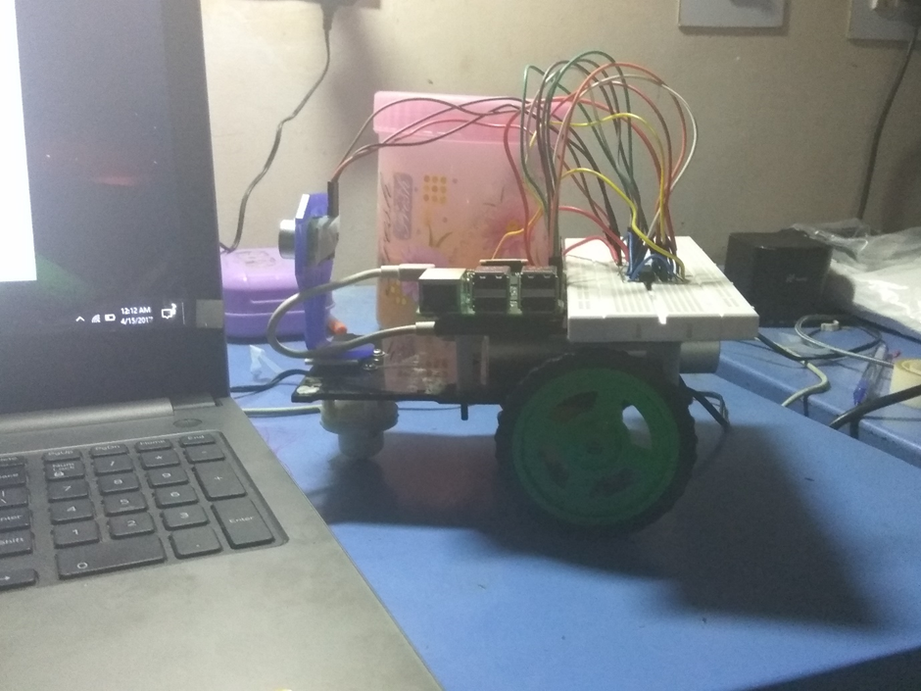
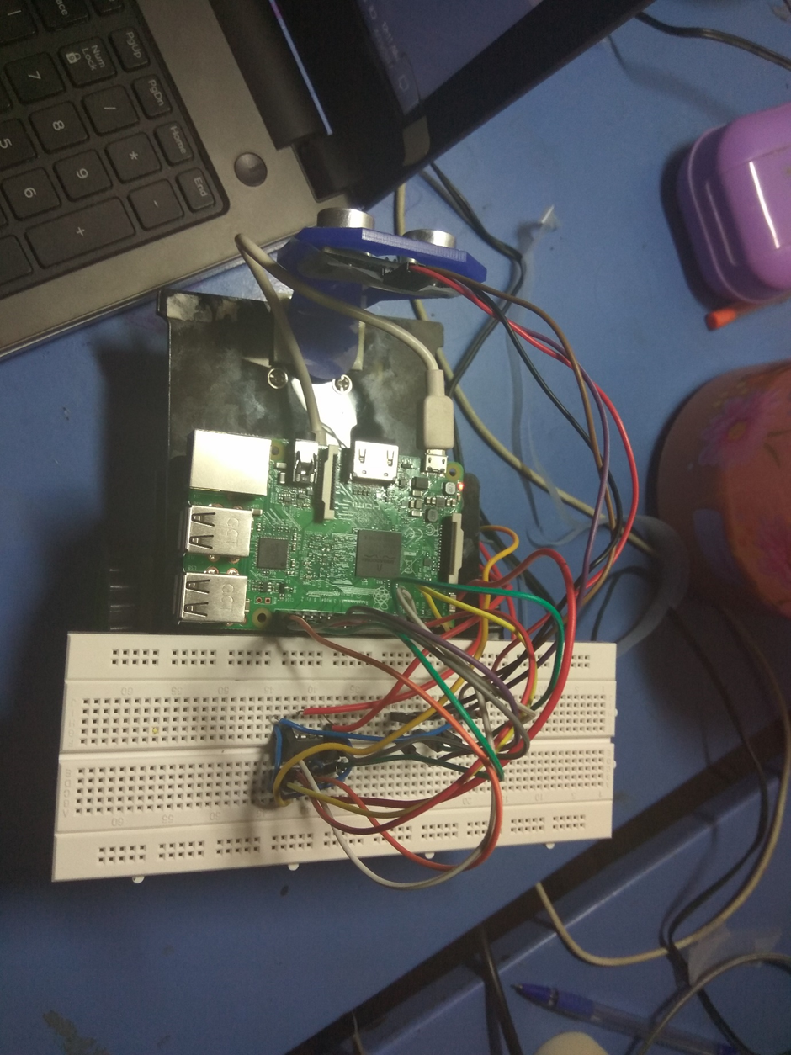
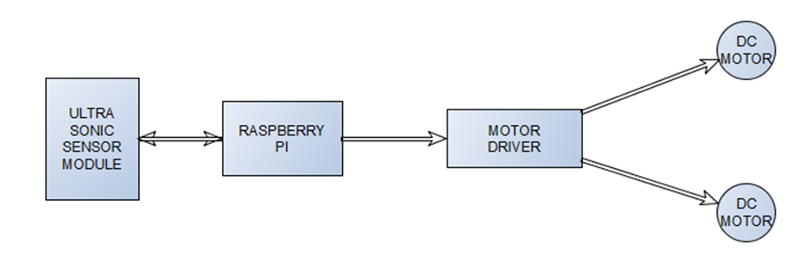
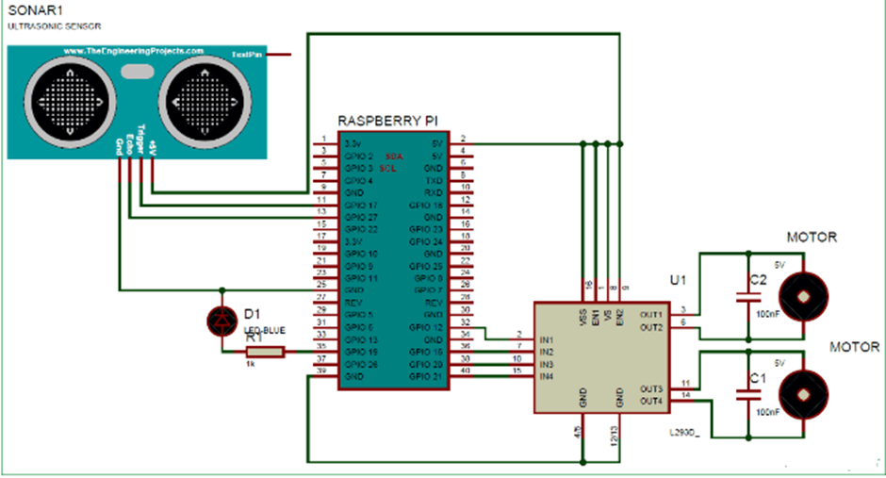
Obstruction Avoidance Robot
Nitin Kathpalia(15BCE0866)| Prof. Jimmy Mathew | SCOPE
Motivation/ Introduction
Requirements
Robots are machines which reduce the human efforts in heavy works by automating the tasks in industries, factories, hospitals etc. Most of the robots are run by using some control unit or components like a push button, remote, joystick, PC, gestures and by executing some command by using controller or processor. But today we are here with a Automatic Robot which moves autonomously without any external events avoiding all the obstacle in its path, yes we talking about Obstacle Avoiding Robot
The main motto of designing such type of Robot or the technology is that this technology can be used in today’s very fast transportation to avoid the accident generally happen in congested or the Metro Politian Areas by applying emergency break. If we use this technology in the car or any vehicle, it will automatically sense the obstacles then it will take a side to the available free space. An obstacle may be a living things or any object. Autonomous Intelligent Robots are robots that can perform desired tasks in unstructured environments without continuous human guidance. Thus by using this technology in vehicles we make the drive safe.
HARDWARE COMPONENT | MODEL
Raspberry PI | 3
Ultrasonic Sensor Module | HC-SR04
Robot Chassis | -
DC Motor | 12V
IC | L293D
Bread Board | 840 points
Resistor | 1K
Capacitor | 100nf
Connecting Wires | -
Power Supply | 12V
SOFTWARE COMPONENTS | VERSION NO.
Raspbian OS | Jessie 6.0.1
VNC Viewer
Python Supported Platform | 3.6.0
SCOPE of the Project
The project
Methodology
The basic idea behind the project is to develop a basic prototype of a robot which can detect and avoid obstacles using an ultrasonic sensor. The ultrasonic sensor mounted on the robot chassis will sense the obstruction and send the signal to raspberry pi. Next, the raspberry pi instructs the IC which acts as the motor controller. This technology can be used for guidance systems for the blind and in self driving cars.
Working of this Autonomous Robot is very easy. When the Robot is powered on and starts running, Raspberry Pi measures the distances of objects, in front of it, by using Ultrasonic Sensor Module and stores in a variable. Then RPi compares this value with predefined values and take decisions accordingly to move the Robot Left, Right, Forward, or backward.
Here in this project, we have selected 15cm distance for taking any decision by Raspberry Pi. Now whenever Raspberry Pi gets less than the 15cm distance from any object then Raspberry Pi stops the robot and moves it back and then turns it left or right. Now before moving it forward again, Raspberry Pi again checks whether any obstacle is present within the range of 15 cm distance, if yes then again repeats the previous process, else move the robot forward until it will detect any obstacle or object again.
Design and Implementation
The above circuit represents the interconnection of components done to develop the robot for the purpose of obstruction avoidance. It uses an ultrasonic sensor to measure the distance from any obstruction whose readings are supplied as input to the L293D IC i.e. the motor driving IC which uses the input to generate output for the motors attached to each wheel. These are interconnected through the raspberry pi which in turn is the controller here and handles the movement of the robot.
Conclusion/ Summary
From this study, a walking robot that achieved the stated objectives had been developed. This robot is able to produce the basic walking movements using two gearmotors. We developed the robot with a very good intelligence which is easily capable to sense the obstacle and by processing the signal coming from the sensor it is perfectly avoiding the obstacle coming in between the path. Robot take the left or right or the forward movement in according to the sensing signal with the help of the two gear motor which makes the movement of the robot smooth. In future, the sensing range can be increased by increasing the sensor quality with the help of ultrasonic sensor or the IR signal spread all over the provide area.
Contact Details
nitin.kathpalia2015@vit.ac.in,naman.garg2015@vit.ac.in
Acknowledgments/ References
Course Faculty Professor Jimmy Mathew

